Slide 1




Internship Evaluation
Others
EPD
ISO
Energy
Maps
Kohler
Sejal Nandgave, ENTC
Organization: Kohler
Role: Project Management Intern
Duration: Aug’23 to Dec’23
Mentor: Vikram Chavan

Slide 2
Role and Projects
Role Offered: Project Management Intern
Team: Sustainability
Objectives:
Promote sustainable practices organization-wide.
Implement energy-efficient solutions.
Ensure compliance with ISO 14001 standards.
Responsibilities:
Assist in planning and executing sustainability projects.
Adhere to project timelines and resources.
Contribute to documentation and reporting tools.
Others
Energy
EPD
ISO
Maps
About
EPD Dashboard
Automation of Maps
Energy Conservation
ISO Documentation
Other Tasks
Environmental Product Declaration (EPD) Dashboard for transparent sustainability reporting.
Automation using Bing Maps to retrieve distances between different plants and locations.
Identify and explore strategies for energy conservation within the organization; ITC Office.
Ensure compliance with ISO standards for sustainability practices.
Handled various tasks and responsibilities related to project management

Slide 3
EPD Dashboard
Problem
Need
Data Extraction
Update SAP
Scattered Data
Difficulty in Plant Identification
Missing/ Outdated Data
Lack of clarity
To address the problems
User-Friendly UI
Enhanced Decision Making
1. Used automation to retrieve data from 500 Excel files.
2. Technology used: Python, Spyder
1. Updated outdated/missing data
2. Ensured the dashboard reflects the latest most accurate data.
Others
EPD
ISO
Energy
Maps
About
Data Preprocessing
Impact
Future Steps
Data Cleaning
Removal of redundant data
Data Filtration
Data Sorting
Maintaining naming convention.
1. Saved time and resources by automating data collection 2. Reduced errors associated with manual data extraction.
Continued Improvements
Documentation for future maintenance and enhancements

Slide 4
EPD Dashboard
Others
EPD
ISO
Energy
Maps
About

Slide 5
Automation of Maps
1. Problem:
Difficulty in obtaining accurate distance data between Kohler plants and vendors location.
Manual methods lead to inefficiencies and potential errors in logistics.
2. Need for Automation:
Enhanced operational efficiency
More reliable
3. Solution: Maps Automation
A. Data Collection:
Gathered data from SAP Logon
B. Preprocessing:
Data preprocessing including filtering and sorting
Gathered Vendor Locations
C. Integration with Bing Maps and Ports.com:
Utilized Bing Maps API for real-time road distance calculations.
Integrated with Ports.com for transoceanic data.
4. Impact:
Significant reduction in errors and enhanced accuracy.
Time and resource savings through automated processes.
COMPARE TIME WITH AND WITHOUT AUTOMATION
Others
ISO
Energy
Maps
EPD
About

Slide 6
Automation of Maps
Others
ISO
Energy
Maps
EPD
About

Slide 7
Energy Conservation
Objective: Identify and explore energy conservation strategies for a more sustainable workplace.
Common Challenges:
Overreliance on artificial lighting and HVAC systems.
Wasteful use of electronic devices and equipment.
Limited awareness and engagement among employees.
Others
ISO
Energy
Maps
EPD
About

Slide 8
Lighting Efficiency
Water Efficiency
System Efficiency
Motion Sensors:
To adjust lighting based on occupancy.
Benefits: Reduces energy wastage in unoccupied areas, optimizing resource utilization.
Greywater Recycling:
Collect & treat greywater from sinks & showers to reuse.
Benefits: Conserves freshwater resources, supports eco-friendly practices.
Energy Generating Floors:
Piezoelectric flooring systems that generate electricity when walked upon.
Benefits: Utilizes a renewable energy source, reduces dependence on external power
Others
ISO
Energy
Maps
EPD
About
HVAC Efficiency
Miscellaneous
Zone Control:
Divide the office into zones with independent smart sensors.
Benefits: Increases energy efficiency, enhances occupant comfort, and reduces overall operational costs.
Reverse Vending Machines
Office waste art competitions
Swap Camps
Donation

Slide 9
ISO Documentation
Objective:
Convert existing SOP (Standard Operating Procedure) files to ISO standardized flow charts.
Process:
Review Existing SOPs:
Examine current SOPs to identify alignment with ISO standards.
Gap Analysis:
Identify gaps between SOP content and ISO requirements.
Alignment and Modification:
Align SOPs with ISO standards, incorporating necessary changes.
Documentation and Version Control:
Create ISO-compliant documentation with proper version control.
Benefits:
Ensures compliance with ISO standards.
Facilitates smoother audits and assessments.
Conclusion:
Efficiently transition from SOPs to ISO documentation for improved quality management.
Others
ISO
Energy
Maps
EPD
About

Slide 10
Other Tasks and Learnings
Shenyang Template:
Task: Updated template for improved consistency and efficiency.
Learning: Enhanced skills in template design and standardization, macros.
Data Extraction from SAP Logon:
Task: Extracted datasets using SAP logon (MKVZ, ZPIR, BOM, etc.).
Learning: Gained proficiency in SAP logon for diverse data extraction tasks.
Excel Tasks:
Task: Completed various tasks in Excel, including data analysis and reporting.
Learning: Developed advanced Excel skills, improving data handling capabilities.
GHG Accounting Terms:
Task: Familiarized with GHG accounting terms.
Learning: Acquired knowledge in sustainability reporting and greenhouse gas accounting.
New Technologies: MS Visio, SAP, Advanced Excel, etc.:
Task: Explored and utilized new technologies like MS Visio, SAP, and advanced Excel.
Learning: Developed proficiency in diverse software applications, enhancing technical skills.
Others
EPD
ISO
Energy
Maps
About

Slide 11
Skills Developed
Data Management
Data Analysis
Project management
Communication
Collaboration
Problem Solving
Time Management
Professional Ethics
Skills
EPD
ISO
Energy
Maps
About

Slide 12



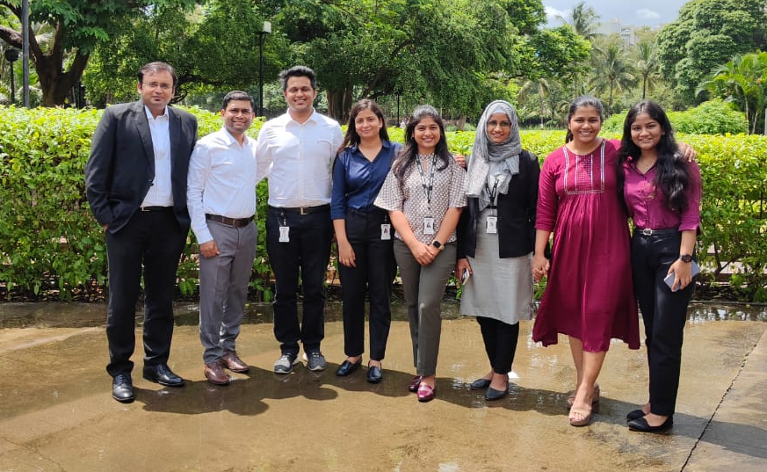
Memories
ISO
EPD
Energy
Memories
Maps
About

Slide 13

Thanks
EPD
ISO
Energy
Maps
About
Thank You

